Slide 1


IoT Based Forest Fire Detection System
MINI-PROJECT FINAL PHASE
Project Name: CODE-RED
Presented By:
Group- G21
Nandini Poddar 1DS19IS063
Neha S Shetty 1DS19IS064
Pankaj Garg 1DS19IS066
Saquib Ameer Khan 1DS19IS089
Guide :
Prof. Vaidehi M
Assistant Professor
Mentor :
Dr. Reshma J
Associate Professor

Slide 2
CONTENTS
Introduction
Problem Statement
Proposed Model
Architecture diagram
Use case diagram
Flow Chart diagram
Implementation
Innovation
SDLC & Testing
Results
Conclusion
References

Slide 3
INTRODUCTION
A wildfire, forest fire, bushfire, wild-land fire or rural fire is an unplanned, uncontrolled fire in an area of combustible vegetation starting in rural and urban areas.
Forest fires not only cause loss of biodiversity, loss of valuable timber, degradation of natural forests and water catchment areas but also result in depletion of carbon sinks, reduction in water table level, global warming, ozone layer depletion and also loss of agricultural production.
So, in order to try and overcome these problems we have proposed an IOT based Forest Fire Detection System.
The Forest fire detection system uses advanced technology which will help in tracing out the forest ﬁre in its initial stage.
The development of IOT based Forest Fire Detection System will be helpful in mapping emergency plans and making them more effective during the occurrence of any disaster.

Slide 4
PROBLEM STATEMENT
Lately the world has seen many occurrences of wildfires which have caused a lot of damage to our biodiversity. These fires have caused damage to wildlife, human life, property and environment.
It could be avoided if a robust system could be deployed in forest areas to detect the fire in its initial stage and alert the concerned authority to take appropriate and immediate action.
Hence our approach addresses the need for an early detection of the forest fire before it spreads to a large scale and causes a number of casualties.
As a result of this automated system, a lot of lives as well as the natural resources could be saved. The approach ensures a more reliable and accurate result and is cost effective at the same time.

Slide 5
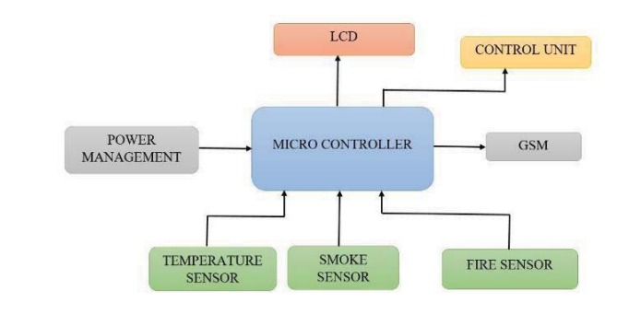
ARCHITECTURAL DIAGRAM

Slide 6
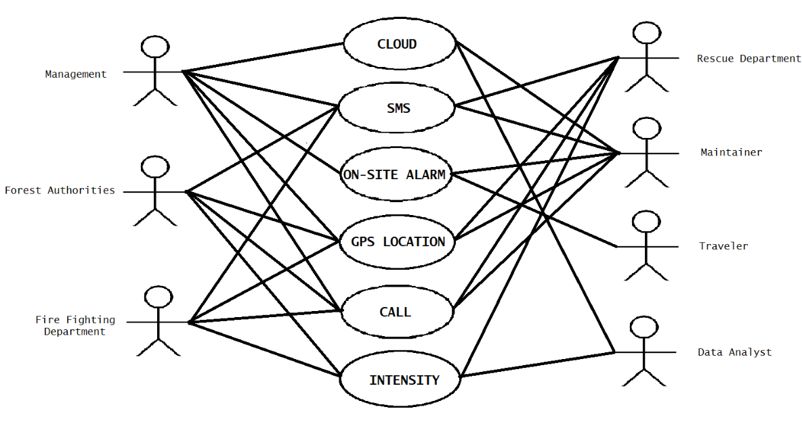
USE-CASE DIAGRAM

Slide 7
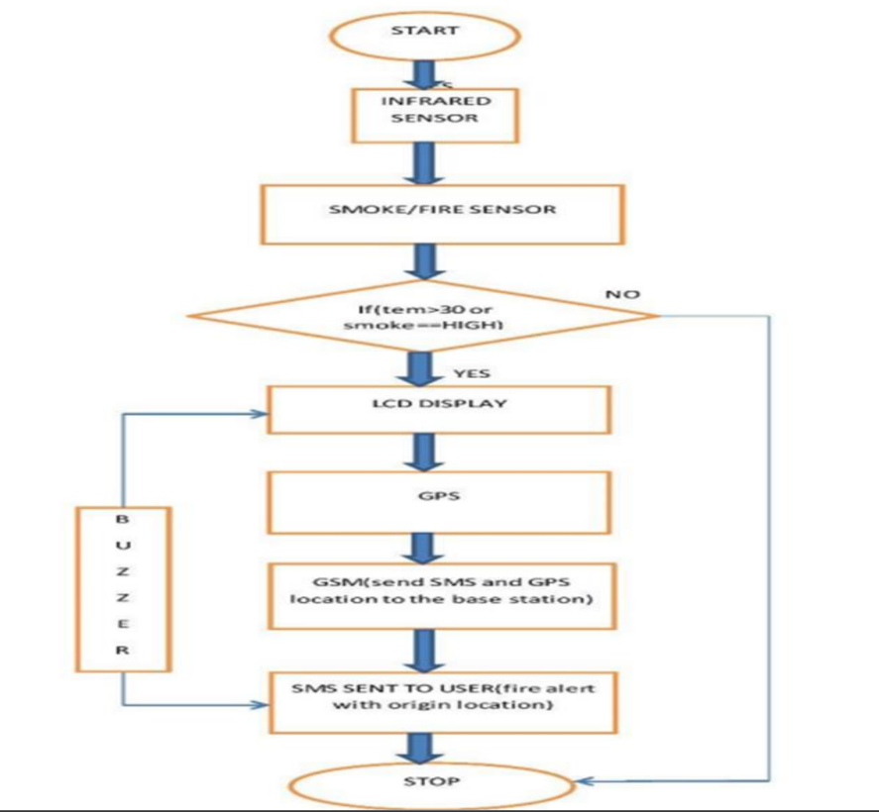
FLOW-CHART DIAGRAM

Slide 8
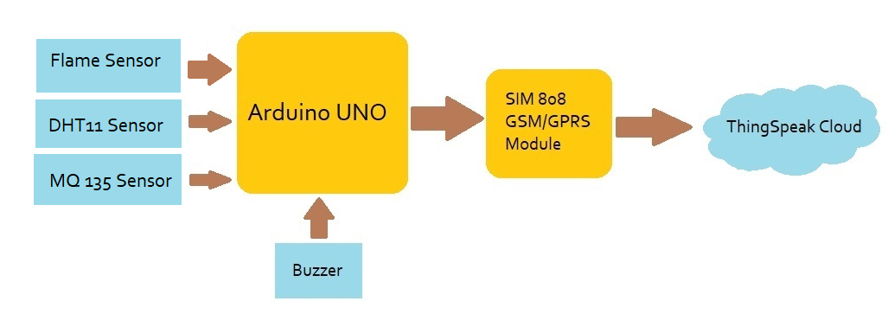
IMPLEMENTATION

Slide 9
IMPLEMENTATION
Connect the Flame sensor, DHT sensor and the CO2 sensor to the microcontroller (Arduino UNO) using Jumper wires and breadboard.
Also connect SIM808 module via Logic shifting resistors.
Connect the buzzer and LEDs for the alarming system.
Supply DC current (9V-1A) to SIM808 module to power it on.
5V DC external supply is given to Arduino UNO for the working of UNO and the sensors.
After successful integration of hardware, Arduino IDE is used to code those components.
Cloud platform needs to be set up, where the real-time data will be received.
Once all the data is received, the intensity of the fire will be estimated and the level of the wild fire will be determined.

Slide 10


Slide 11
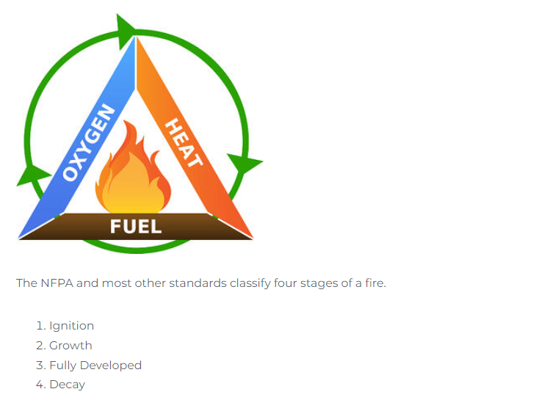
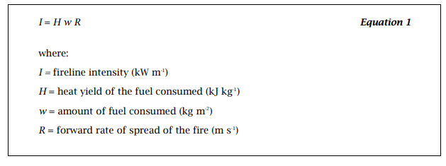
DETERMINING THE FIRE INTENSITY
The extent of a forest fire is classified into 3 stages:
Ignition (Low)
Growth (Medium)
Fully Developed (High)
Byram’s formula:

Slide 12
Proposed Formula:
We know that,
Intensity is directly proportional to Temperature.
Intensity is directly proportional to Concentration of CO2 present in the air.
Intensity is inversely proportional to Relative Humidity of the atmosphere.
Thus using the concept of Byram’s Formula, we have extended the formula as follows:
I = [ (T * C * k ) / H ] - 1.2
where,
T= Temperature (in degrees celsius)
C= Concentration of CO2 present in the air(in ppm)
H= Relative humidity of the atmosphere (in RH)
k= proportionality constant
= 5.397 x 10⁻³ ( RH per ppm per degree celsius)

Slide 13
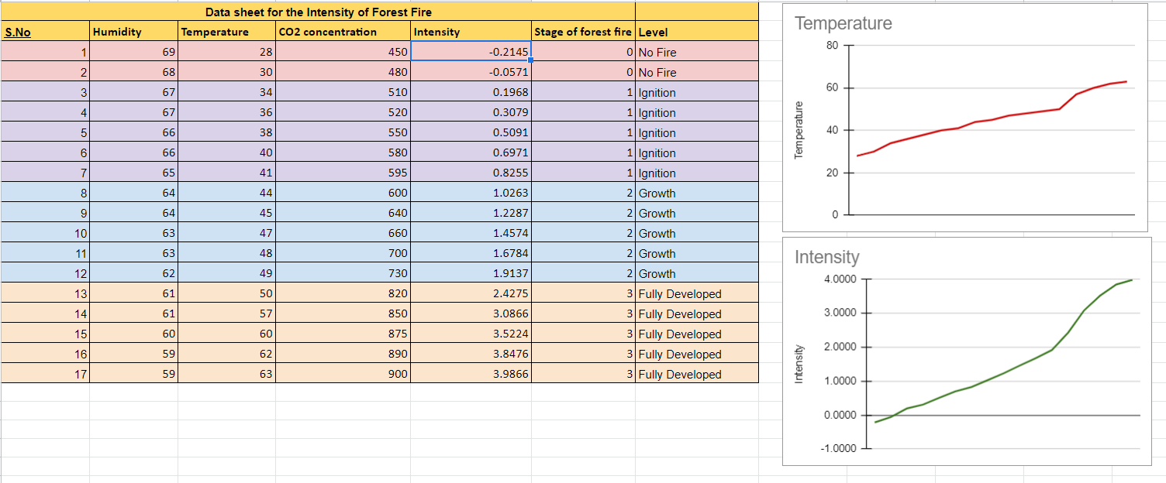

Slide 14
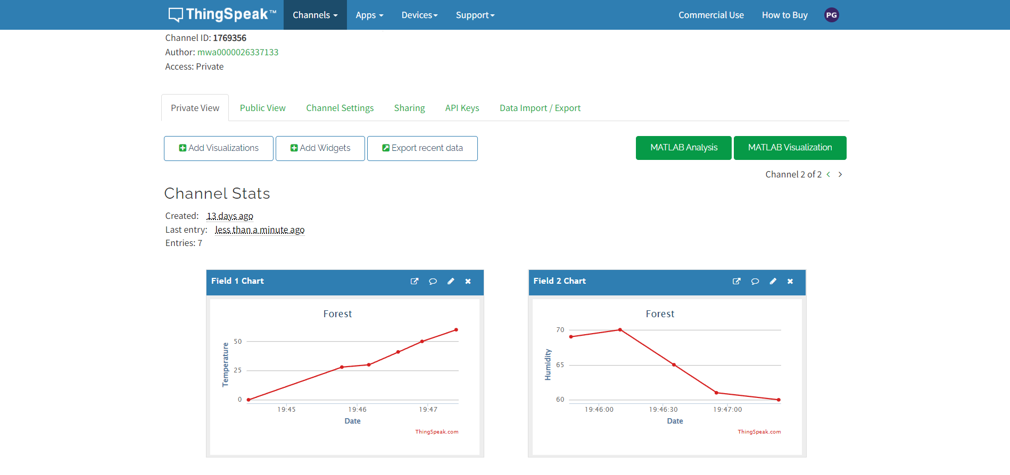
Integration of Cloud
ThingSpeak, an open source cloud is integrated with the device with the help of an API to visualise the data in a graphical format (line graph) and to understand the changes in the physical parameters during the incident.

Slide 15
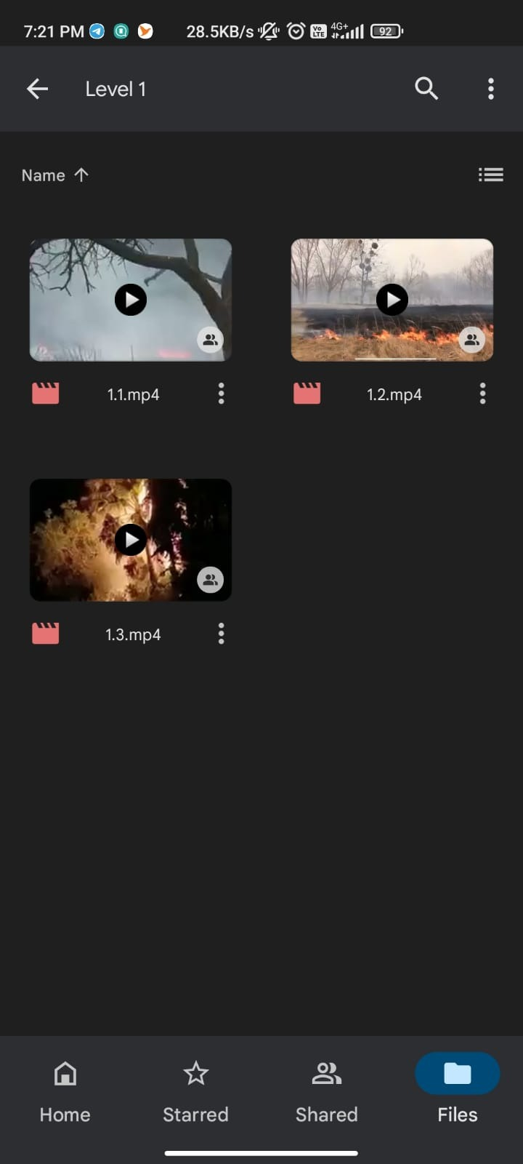
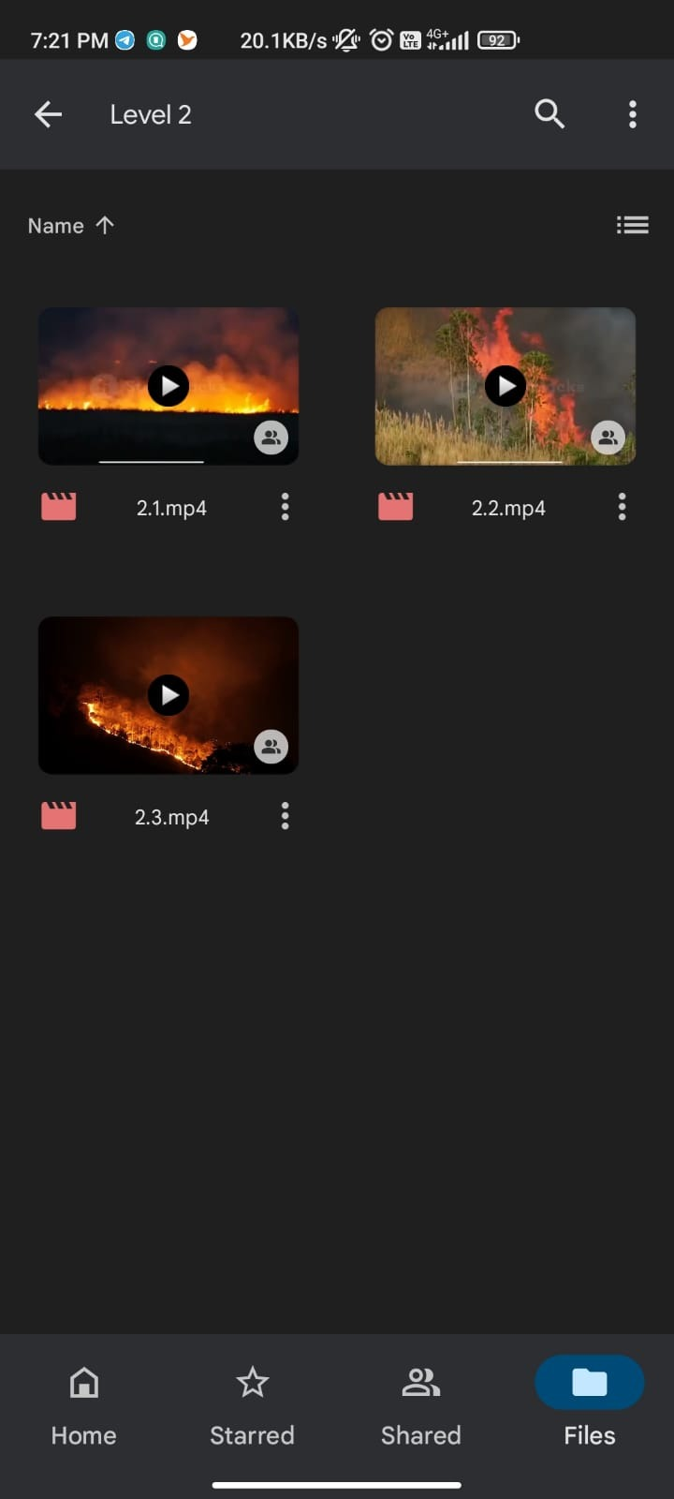
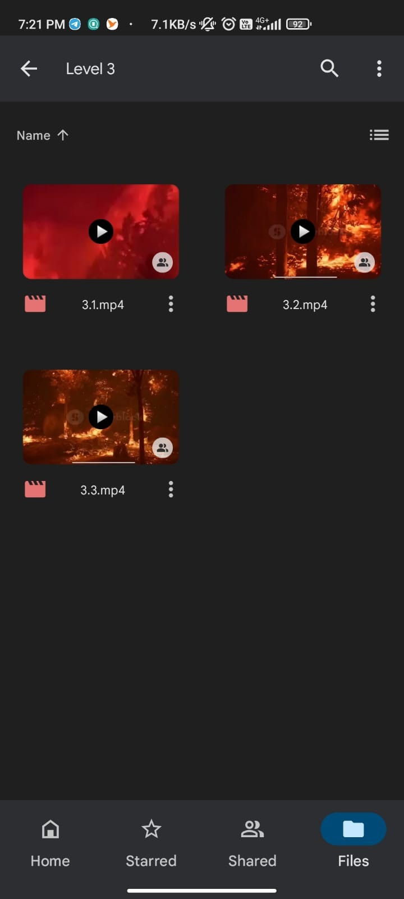
Clips of the current state
The authorities are informed about the current scenario at the site of incident by an SMS containing a google drive link which has a few video clips.
Currently, we have uploaded pre-recorded videos in the drive.
As a future scope, clips of 10 sec each showing the status of the scenario will be posted in the drive at regular intervals of time.

Slide 16
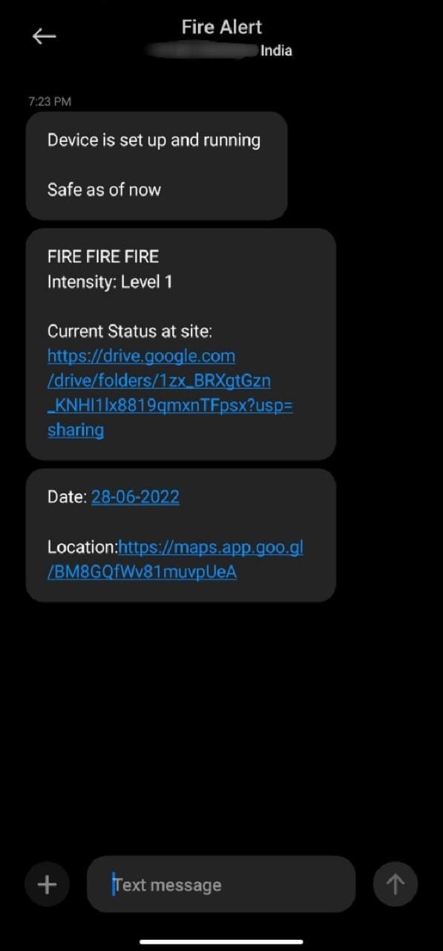
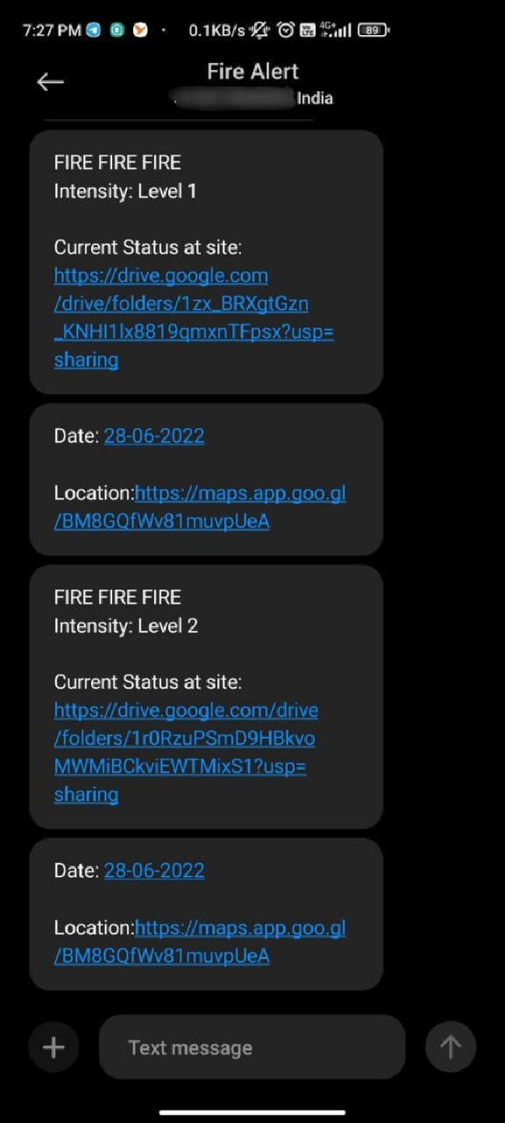
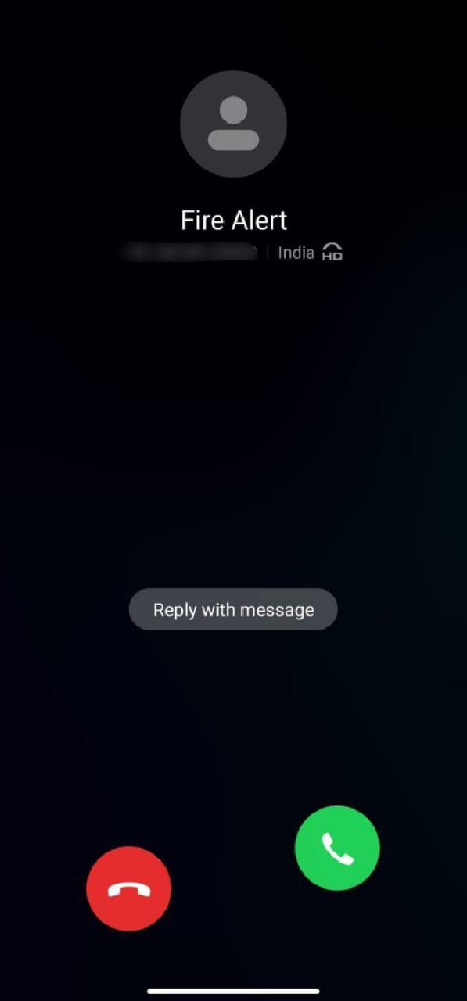
Intimating the Authorities
Authorities are informed about the forest fire at the earliest.
It is done in 2 ways:
SMS: A customised sms is sent to the authority based on the intensity of the fire along with the date and location to ensure that appropriate measures will be taken.
Call: As a precautionary measure in case there is a delay in sending or receiving the SMS, a call is given.

Slide 17

Buzzing Alarm at the site
As a matter of fact all the animals (domestic or wild) and humans are hardwired by evolution to find loud noises frightening. Hence a high frequency buzzing sound is generated when the fire breaks out which helps in creating a sense of alarm within them and evacuate the hotspots thus, saving many lives.
For now, the buzzer is audible upto a range of 4 m.
A future scope implementation would be to create an alarm with a range of about 4-6 km.

Slide 18
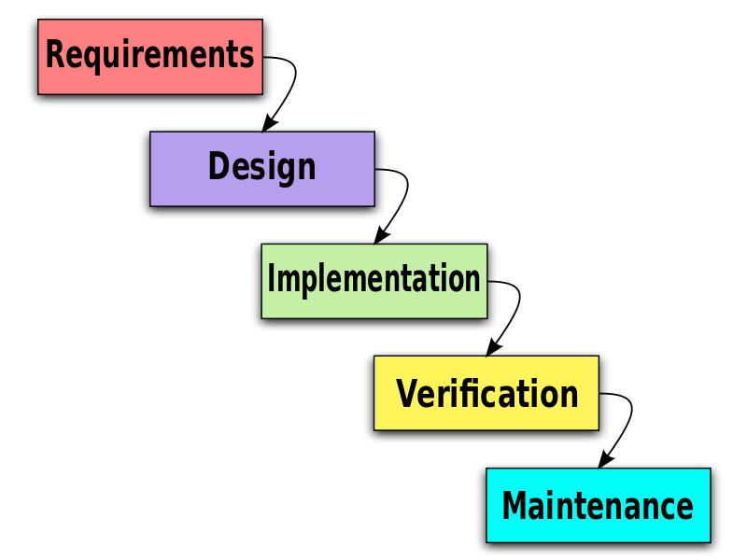
SDLC - Waterfall Model
The Waterfall methodology prevails when the project is constrained by cost and/or time, and the requirements and scope are well understood. In these cases, the Waterfall methodology provides a set of processes that are built on the principle of approval of the previous phase.

Slide 19
Quality control - TESTING
Smoke Testing - smoke tests verifies if the most important functionality is working. Detecting fire and determining the intensity was rigorously tested.
Black box Testing - Black box testing assesses a system solely from the outside, without the operator or tester knowing what is happening within the system to generate responses to test actions.
White box Testing - White box testing is an approach that allows testers to inspect and verify the inner workings of a software system. Various paths, statements, conditions and loops were closely examined.
Unit Testing - Unit testing is a software development process in which the smallest testable parts of an application, called units, are individually and independently scrutinized for proper operation.
Integration testing (Bottom- up) - A type of software testing in which the different units, modules or components of a software application are tested as a combined entity.

Slide 20
RESULTS
The output of the proposed system is as follows:
The fire and smoke sensors detect the respective elements and this initializes an alert and activates the system. This, in turn, sends the location, which is detected by the GPS module, with an alert message via SMS to the user with the help of the GSM module that has been incorporated into the system. Once the user receives the alert message, the required action can be taken to control and cease the fire.
The wireless transmission using RF, from one node to another node was experimented up to 1m. As there would not be any obstructions in the forest, the RF modules can work up to one meter efficiently. For GSM module to work properly, there should be a minimum network coverage to send an SMS with location. The nodes can be placed 1m away from each other, for maximum coverage of the forest area with minimum number of nodes and to perform with good efficiency. The fire and smoke sensors were tested up to 1m.

Slide 21
CONCLUSION
Early cautioning and quick reaction to a fire breakout are the main approaches to
dodge incredible misfortunes and natural and social legacy harms. Hence, the most
critical objectives in flame observation are fast and solid identification and restriction of the fire. In light of this data, the fire battling staff can be guided on focus to hinder the fire before it achieves social legacy destinations and to smother it rapidly by using the required putting out fires’ hardware and vehicles.
The improved system can be deployed for tenement appliances and in industries
also. However, the system above is meant for sincere opinion news only. As a tomorrow aggravation, several-decision companies through the IOT landing are studying an object and the exploration is being done to effectuate this enormous toil.
The fire and smoke sensors detect the respective elements and this initializes an
alert and activates the system. This, in turn, sends the location, which is detected by the GPS module, with an alert message via SMS to the user with the help of the GSM module that has been incorporated into the system.

Slide 22
REFERENCES
IEEE-
Published in: 2019 IEEE International Conference on System, Computation, Automation and Networking (ICSCAN)
Author:
A. Divya- IFET College of Engineering, Villupuram, India
T. Kavithanjali- IFET College of Engineering, Villupuram, India
P. Dharshini- IFET College of Engineering, Villupuram, India
DOI: 10.1109/ICSCAN.2019.8878808
Conference Location: Pondicherry, India
Link- https://ieeexplore.ieee.org/document/8878808
Proposed model: Detection of fire with the use of optical sensor and digital cameras.

Slide 23
IRJET-
Volume: 08
Issue: 04 | Apr 2021
Authors:
Indu priya R
Ria George
Nisha Naveen
Dayita Banerjee
Alla srija
e-ISSN: 2395-0056
p-ISSN: 2395-0072
Link- https://www.irjet.net/archives/V8/i4/IRJET-V8I4360.pdf
Proposed Model: IoT based model comprising of flame sensor to detect the forest fire.

Slide 24


